Slide 1

PRESENTATION TITLE
Project 4 Group 7 : Spotify Data Analysis
Caroline Badocha, Robbie Hockley & Angela Alexander Smith
Month
20XX
Presentation Tagline
This Photo by Unknown Author is licensed under CC BY-NC-ND

Slide 2

BACKGROUND
Using the linked dataset🎹 Spotify Tracks Dataset | Kaggle, which is pulling data from Spotify’s own API, we aim to answer the following questions and provide a range of visualizations:
1. How does Genre impact popularity?
2. How does Length of Song impact popularity?
3. What other attributes impact a song's popularity?
We then utilized this data to complete predictions for the future and host our visualizations on Tableau Public

Slide 3

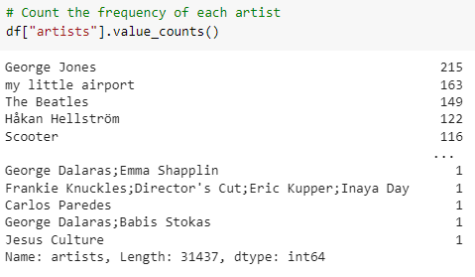
This Photo by taka8664r is licensed under Wallpapers.com
We found a few limitations to the dataset including that there were multiple songs that were incorrectly genred and that there were some records that the tempo did not seem to be accurate based on our assessment of the song. Additionally, songs where there has been a collaboration between artists are being treated as a separate "artist" category which can skew the data for Top Artists.

Slide 4
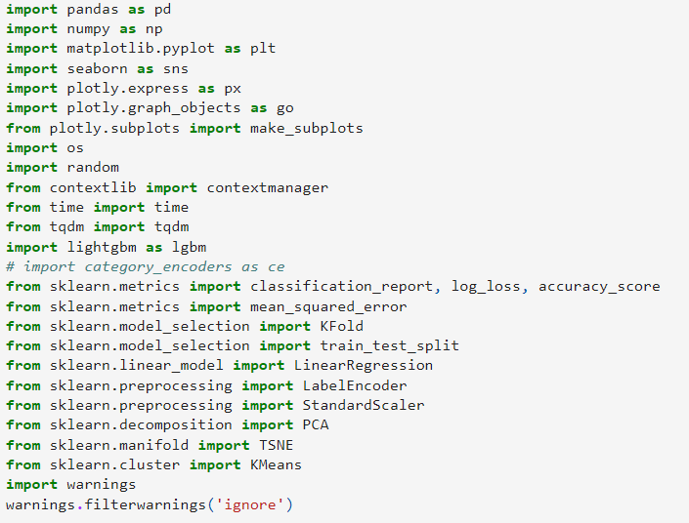
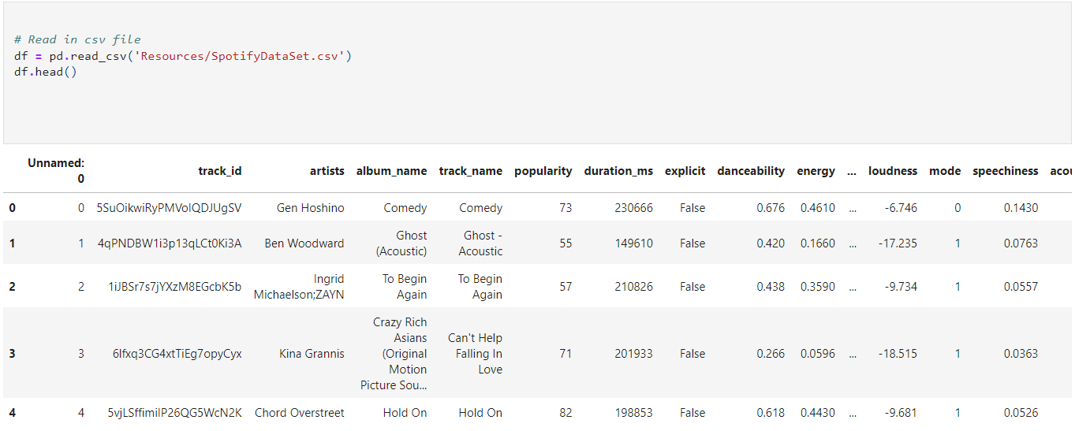
This Photo by taka8664r is licensed under Wallpapers.com
We imported the following dependencies:
And then read in the data set into our Jupyter Notebook:

Slide 5

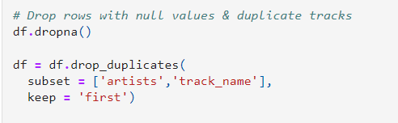
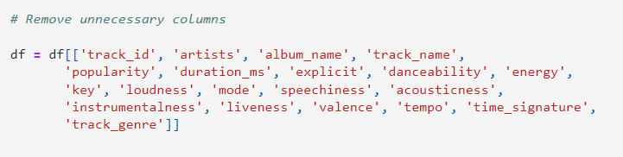
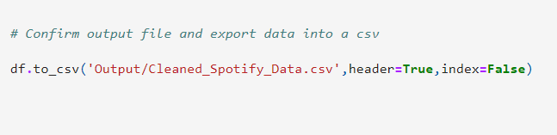
We then completed data cleaning on the original dataset to drop NA values and duplicated data as well as removing unnecessary columns before outputting this to a new csv file
We then performed some initial data analysis to get a better idea of the data we were looking at including frequency of artists, value counts of genre, popularity of genre & sum of total popularity

Slide 6
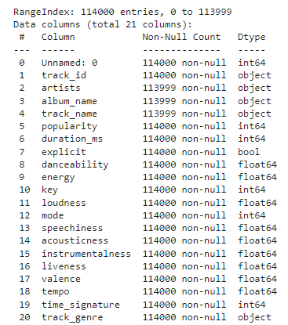
The dataset contained a range of attributes for each track.
Popularity is a scale of 0 to 100 and is calculated by an algorithm based on the total number of plays and how recent those plays are.
The values for attributes such as accousticness, danceability, energy, liveness are all calculated by Spotify.
Notes:
track_id: The Spotify ID for the track
artists: The artists' names who performed the track. If there is more than one artist, they are separated by a ;
album_name: The album name in which the track appears
track_name: Name of the track
popularity: The popularity of a track is a value between 0 and 100, with 100 being the most popular. The popularity is calculated by algorithm and is based, in the most part, on the total number of plays the track has had and how recent those plays are. Generally speaking, songs that are being played a lot now will have a higher popularity than songs that were played a lot in the past. Duplicate tracks (e.g. the same track from a single and an album) are rated independently. Artist and album popularity is derived mathematically from track popularity.
duration_ms: The track length in milliseconds
explicit: Whether or not the track has explicit lyrics (true = yes it does; false = no it does not OR unknown)
danceability: Danceability describes how suitable a track is for dancing based on a combination of musical elements including tempo, rhythm stability, beat strength, and overall regularity. A value of 0.0 is least danceable and 1.0 is most danceable
energy: Energy is a measure from 0.0 to 1.0 and represents a perceptual measure of intensity and activity. Typically, energetic tracks feel fast, loud, and noisy. For example, death metal has high energy, while a Bach prelude scores low on the scale
key: The key the track is in. Integers map to pitches using standard Pitch Class notation. E.g. 0 = C, 1 = C♯/D♭, 2 = D, and so on. If no key was detected, the value is -1
loudness: The overall loudness of a track in decibels (dB)
mode: Mode indicates the modality (major or minor) of a track, the type of scale from which its melodic content is derived. Major is represented by 1 and minor is 0
speechiness: Speechiness detects the presence of spoken words in a track. The more exclusively speech-like the recording (e.g. talk show, audio book, poetry), the closer to 1.0 the attribute value. Values above 0.66 describe tracks that are probably made entirely of spoken words. Values between 0.33 and 0.66 describe tracks that may contain both music and speech, either in sections or layered, including such cases as rap music. Values below 0.33 most likely represent music and other non-speech-like tracks
acousticness: A confidence measure from 0.0 to 1.0 of whether the track is acoustic. 1.0 represents high confidence the track is acoustic
instrumentalness: Predicts whether a track contains no vocals. "Ooh" and "aah" sounds are treated as instrumental in this context. Rap or spoken word tracks are clearly "vocal". The closer the instrumentalness value is to 1.0, the greater likelihood the track contains no vocal content
liveness: Detects the presence of an audience in the recording. Higher liveness values represent an increased probability that the track was performed live. A value above 0.8 provides strong likelihood that the track is live
valence: A measure from 0.0 to 1.0 describing the musical positiveness conveyed by a track. Tracks with high valence sound more positive (e.g. happy, cheerful, euphoric), while tracks with low valence sound more negative (e.g. sad, depressed, angry)
tempo: The overall estimated tempo of a track in beats per minute (BPM). In musical terminology, tempo is the speed or pace of a given piece and derives directly from the average beat duration
time_signature: An estimated time signature. The time signature (meter) is a notational convention to specify how many beats are in each bar (or measure). The time signature ranges from 3 to 7 indicating time signatures of 3/4, to 7/4.
track_genre: The genre in which the track belongs

Slide 7
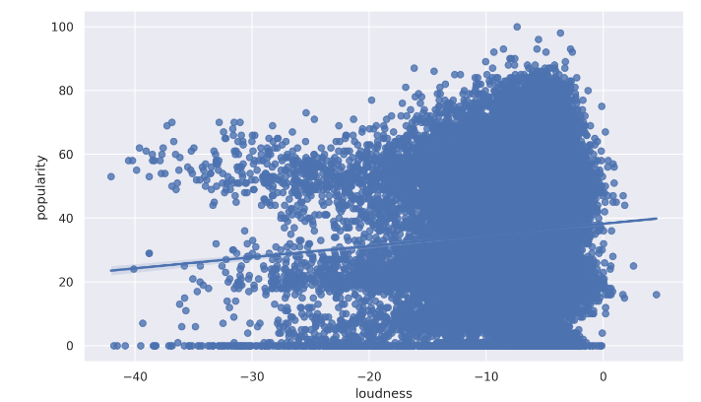
We used seaborn to plot some basic visualizations in the notebook of popularity vs loudness, danceability vs popularity, energy vs popularity & tempo vs popularity finding that loudness & popularity were most strongly correlated

Slide 8
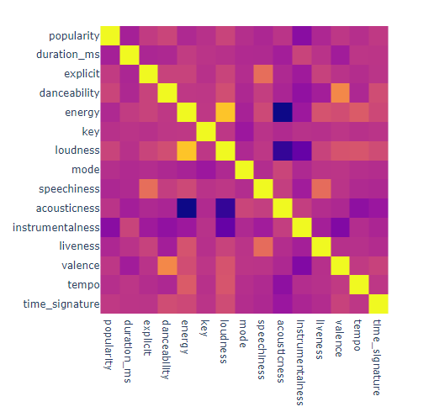
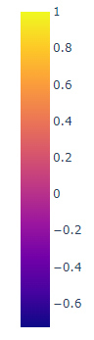
Looking further into the relationship between the attributes there are some key relationships:
Strong positive correlation between Energy & Loudness
Strong negative correlation between Accousticness and Loudness
Strong negative correlation between Accousticness and Energy
Note that Energy doesn't have a similar correlation with Popularity given the strong correlation between Loudness and Energy.

Slide 9
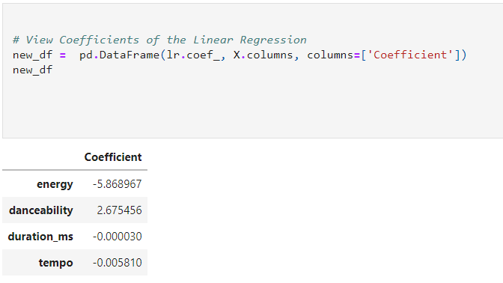
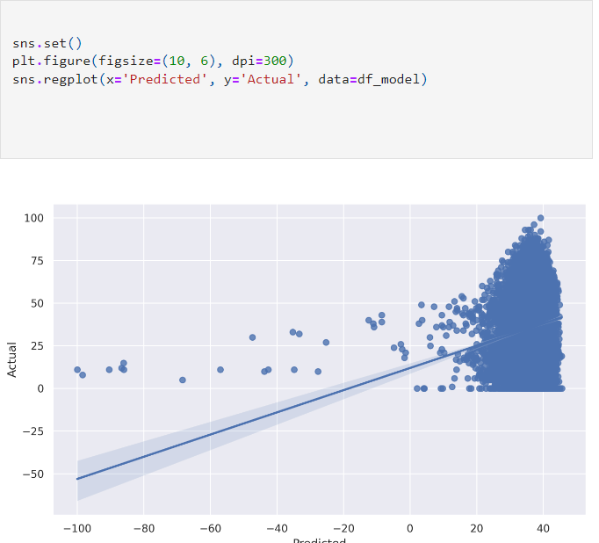
Using Machine Learning we then aimed to make some predictions around the data.

Slide 10
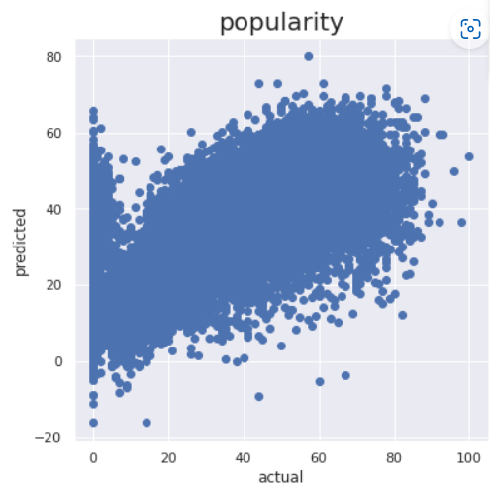
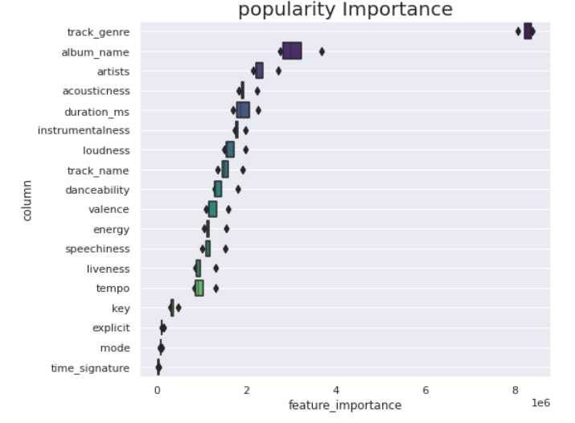
Using Kfold cross validation we split the data into 5 splits and then visualized this to look at popularity importance

Slide 11
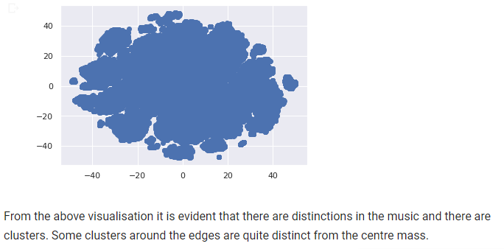
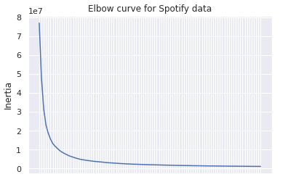
We then used StandardScalar to standardise the data and initiated the PCA model before transforming this PCA data into a dataframe. Using this dataframe we initialised the t-SNE model and created a plot to visualize the clusters as well as creating an elbow curve of the data

Slide 12
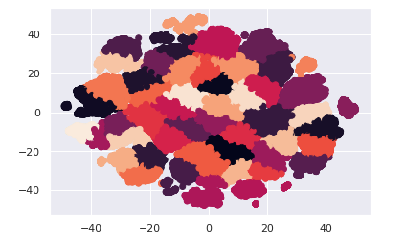
While we had a variety of attributes for each track it is evident post the classification by the Machine Learning that those attributes alone aren’t distinctive enough to perfectly classify a genre.

Slide 13
Following this we then migrated to Tableau Public to create further visualizations that are available at the following link: shorturl.at/BFHW7

